Slide 1
Les Loisirs
150-151

Slide 2
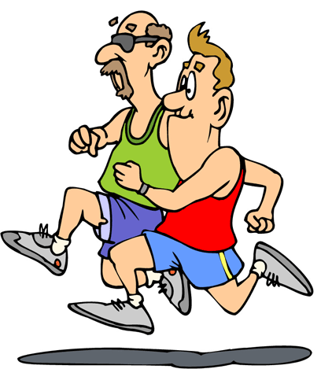
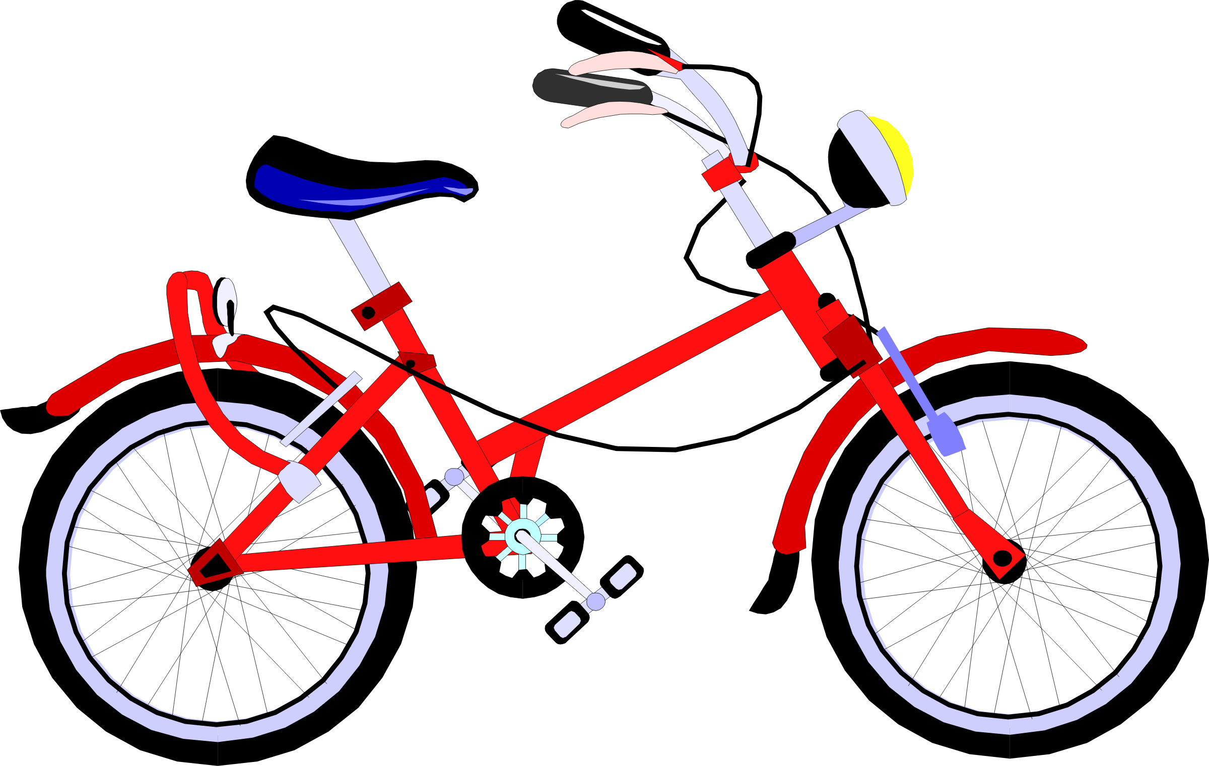
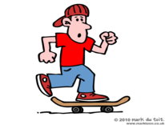
Faire du vélo
Faire de la vidéo
Faire du skate(board)
Faire du jogging
This Photo by Unknown Author is licensed under CC BY-SA
This Photo by Unknown Author is licensed under CC BY-SA
This Photo by Unknown Author is licensed under CC BY

Slide 3
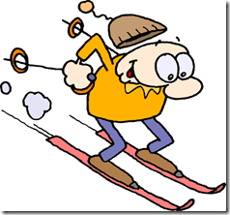
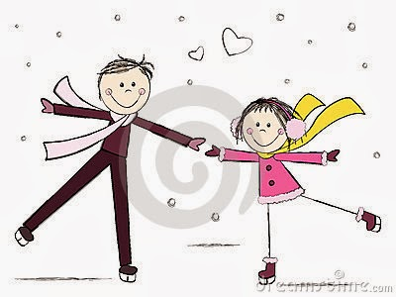
Faire du ski
Faire du patin à glace
Faire du surf
Faire de la photo
This Photo by Unknown Author is licensed under CC BY-NC-SA
This Photo by Unknown Author is licensed under CC BY-SA
This Photo by Unknown Author is licensed under CC BY-SA

Slide 4
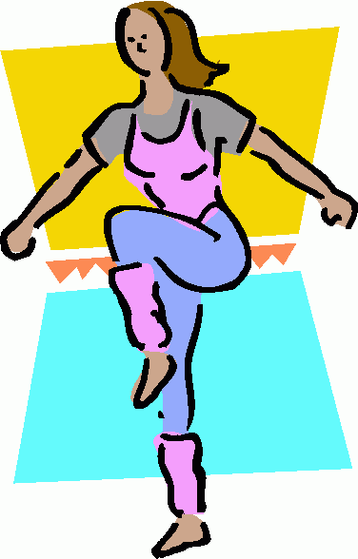
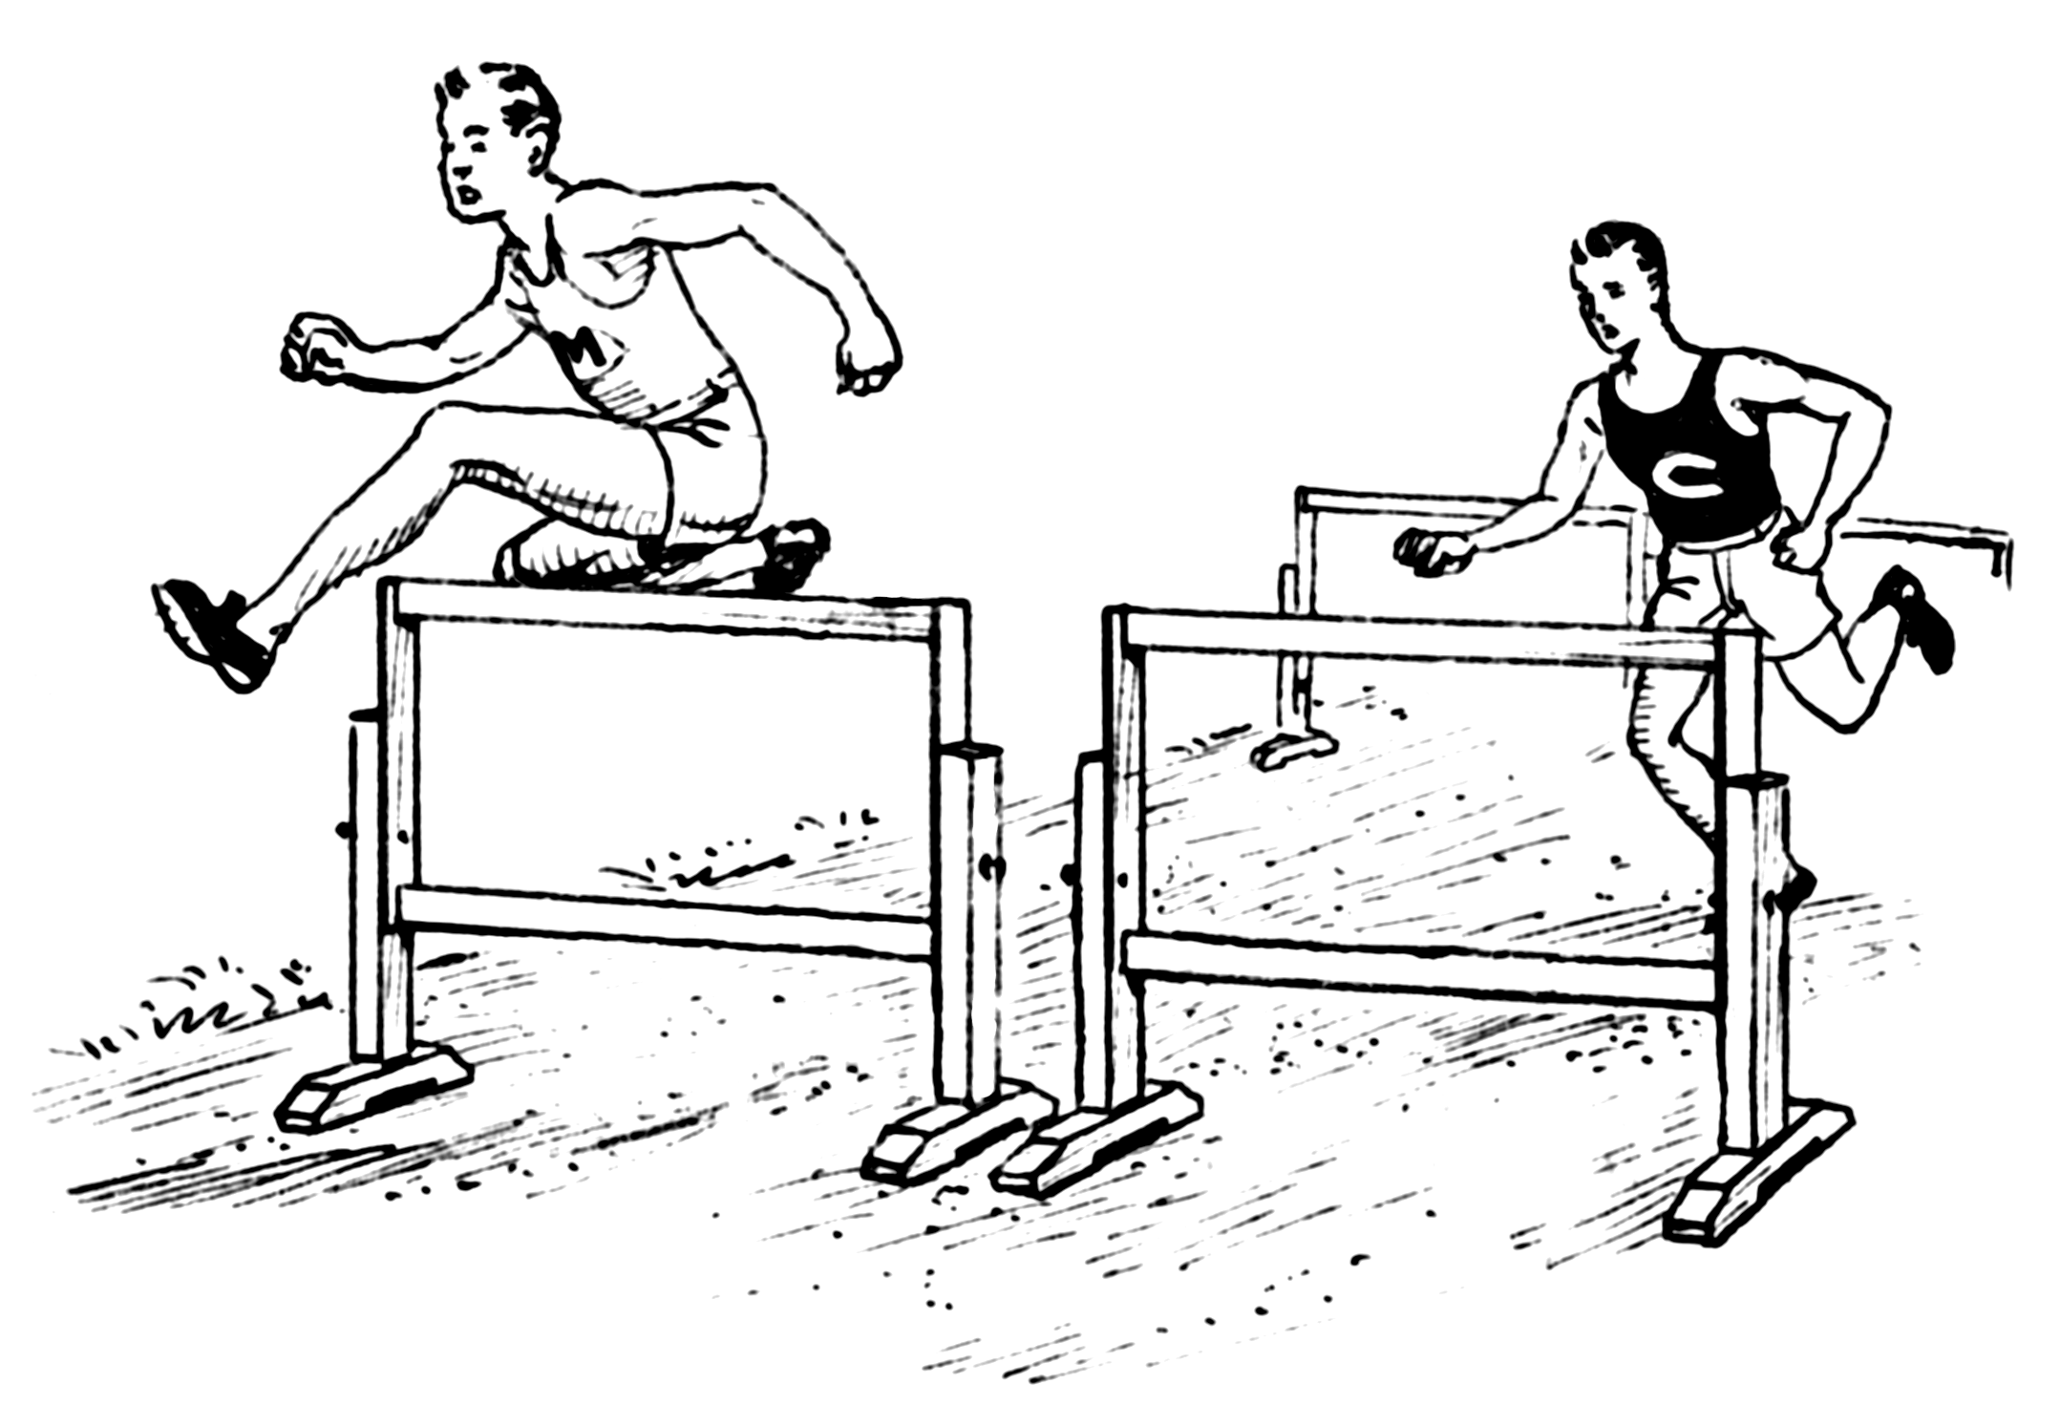
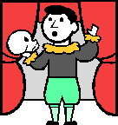
Faire du théâtre
Faire de l’athlétisme
Faire de l’aérobique
This Photo by Unknown Author is licensed under CC BY-SA
This Photo by Unknown Author is licensed under CC BY-SA
This Photo by Unknown Author is licensed under CC BY-SA

Slide 5
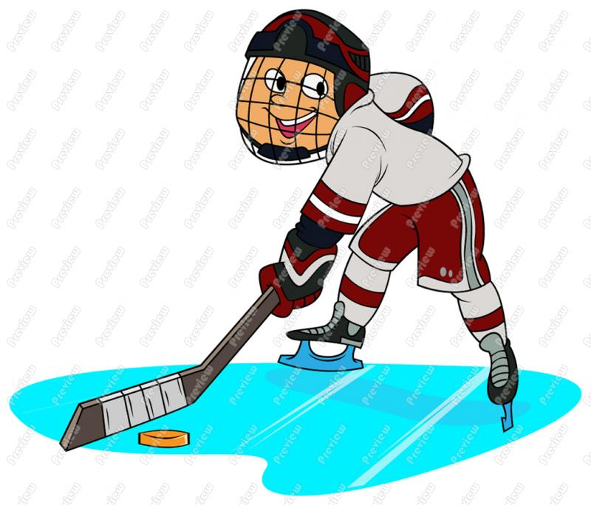
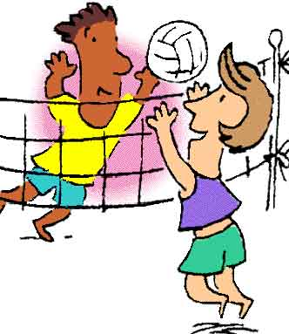
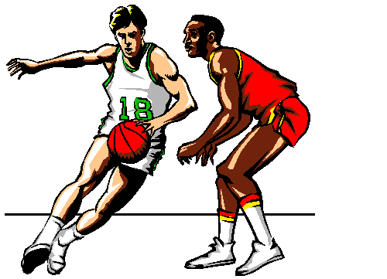
Jouer au basket
Jouer au volley
Jouer au hockey
Jouer au tennis
This Photo by Unknown Author is licensed under CC BY-NC-SA
This Photo by Unknown Author is licensed under CC BY-NC-SA
This Photo by Unknown Author is licensed under CC BY-SA
This Photo by Unknown Author is licensed under CC BY-SA

Slide 6
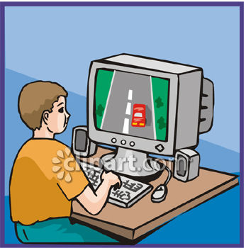
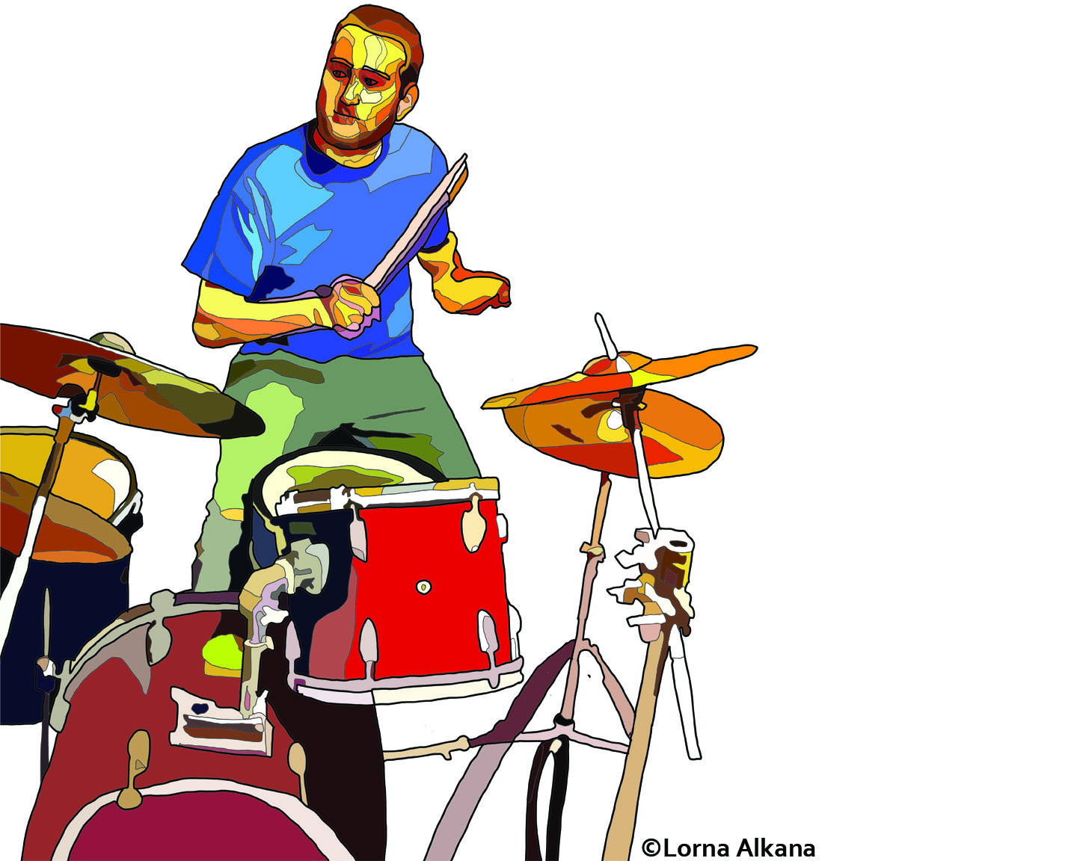
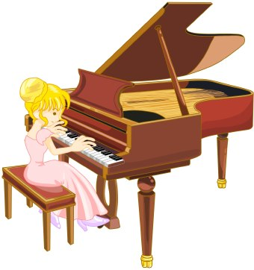
Jouer du piano
Jouer de la batterie
Jouer de la guitare
Jouer à des jeux vidéo
This Photo by Unknown Author is licensed under CC BY-ND
This Photo by Unknown Author is licensed under CC BY-ND
This Photo by Unknown Author is licensed under CC BY-NC-ND
This Photo by Unknown Author is licensed under CC BY

Slide 7
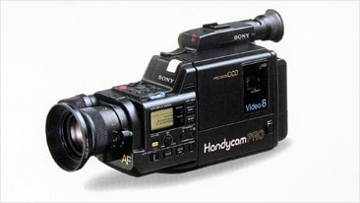
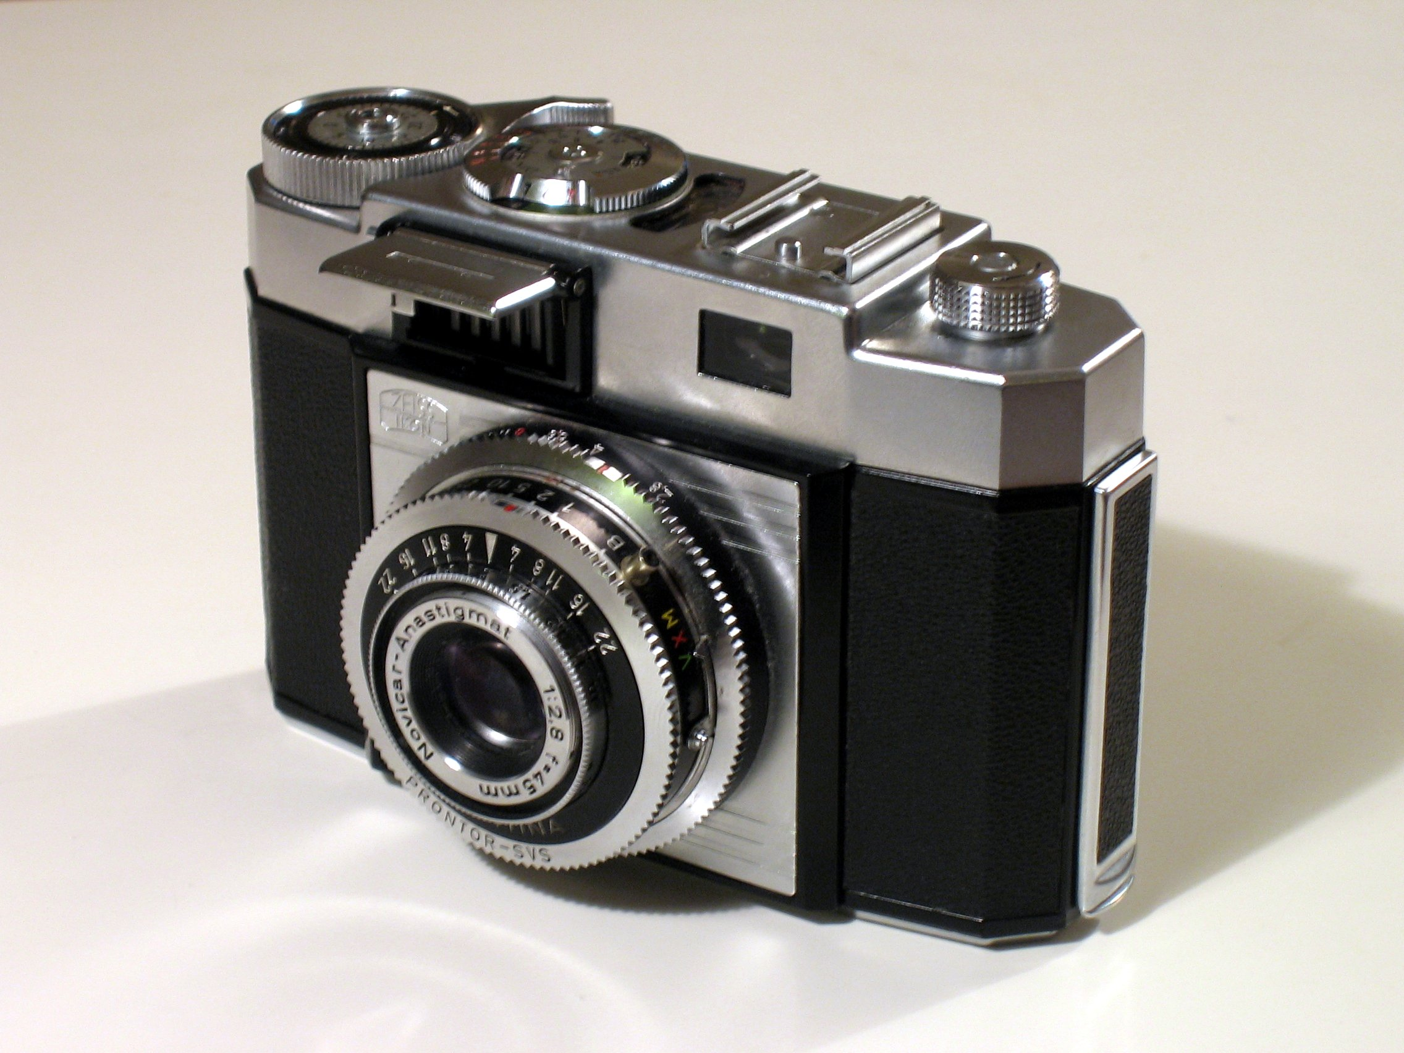
Le caméscope
L’appareil-photo
L’appareil-photo numérique
La casque
La saison
This Photo by Unknown Author is licensed under CC BY-SA
This Photo by Unknown Author is licensed under CC BY
This Photo by Unknown Author is licensed under CC BY-NC-ND
This Photo by Unknown Author is licensed under CC BY-SA

